Slide 1
Carbon “IN” to terrestrial ecosystems

Slide 2
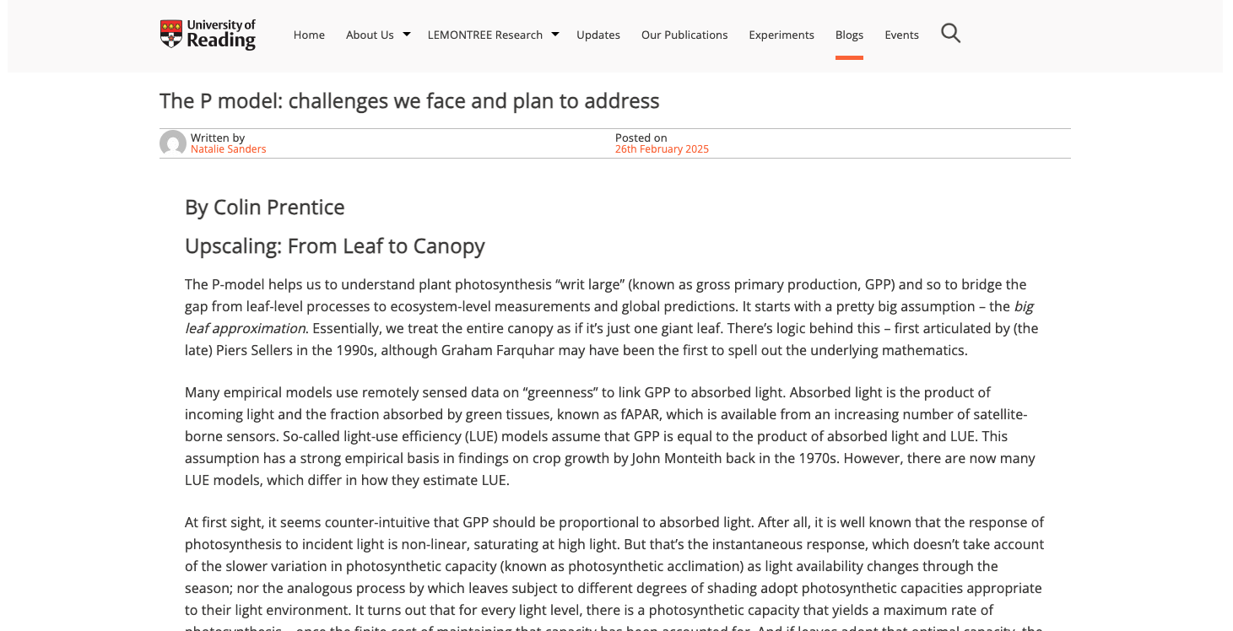
https://research.reading.ac.uk/lemontree/the-p-model-challenges-we-face-and-plan-to-address/

Slide 3
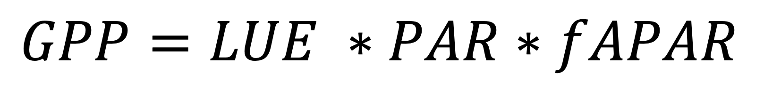
Light use efficiency models
GPP is the product of the absorbed PAR (PAR*fAPAR) and the efficiency by which PAR is converted to carbon (or LUE; µmol CO₂ µmol PAR⁻¹)
$$GPP=LUE ∗PAR∗fAPAR$$

Slide 4
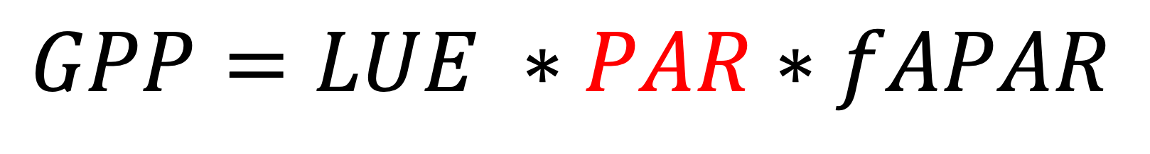
Light use efficiency models
GPP is the product of the absorbed PAR (PAR*fAPAR) and the efficiency by which PAR is converted to carbon (or LUE; µmol CO₂ µmol PAR⁻¹)
$$GPP=LUE ∗PAR∗fAPAR$$

Slide 5
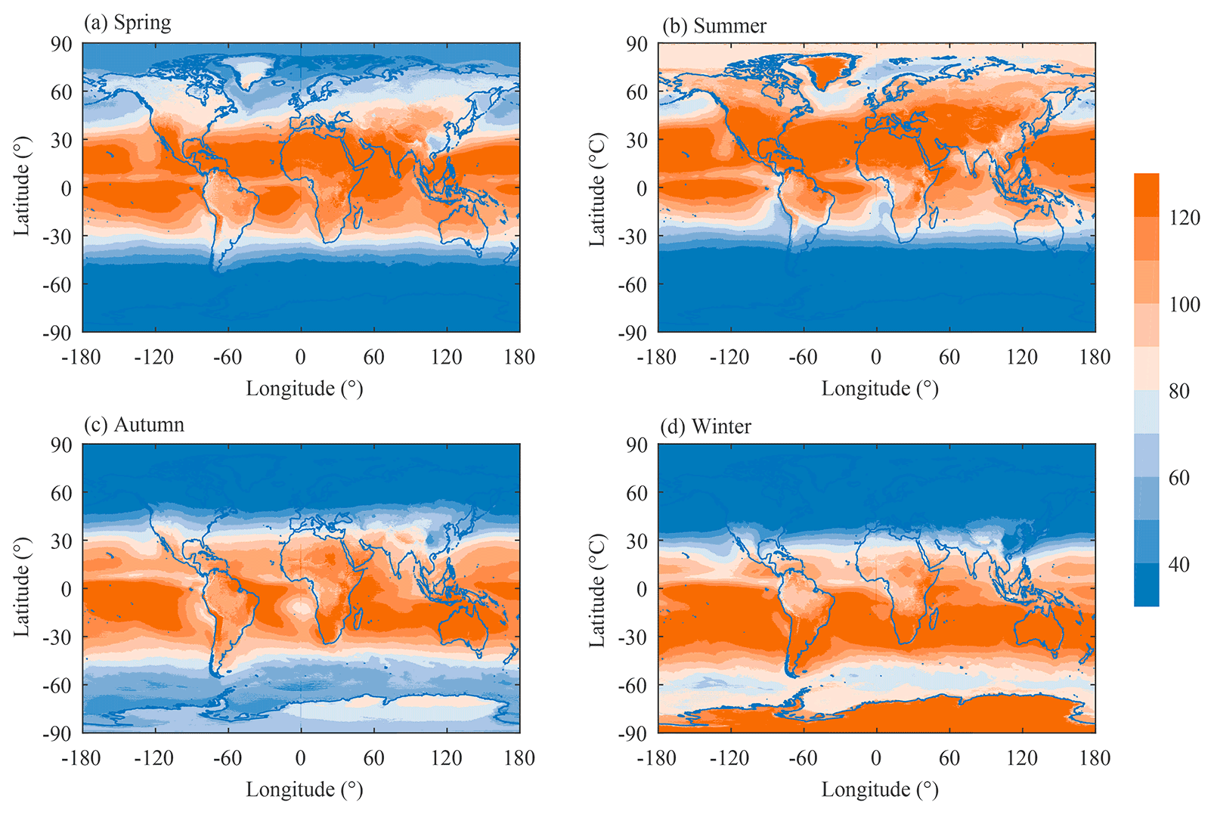
PAR
Photosynthetically active radiation reaching the top of the canopy
Tang et al. (2022)

Slide 6
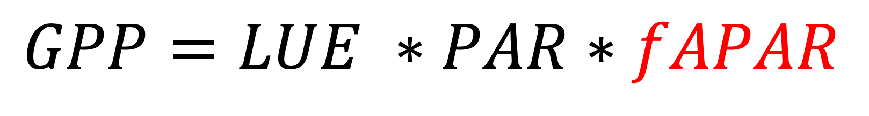
Light use efficiency models
GPP is the product of the absorbed PAR (fAPAR) and the efficiency by which PAR is converted to carbon (or LUE; µmol CO₂ µmol PAR⁻¹)
$$GPP=LUE ∗PAR∗fAPAR$$

Slide 7
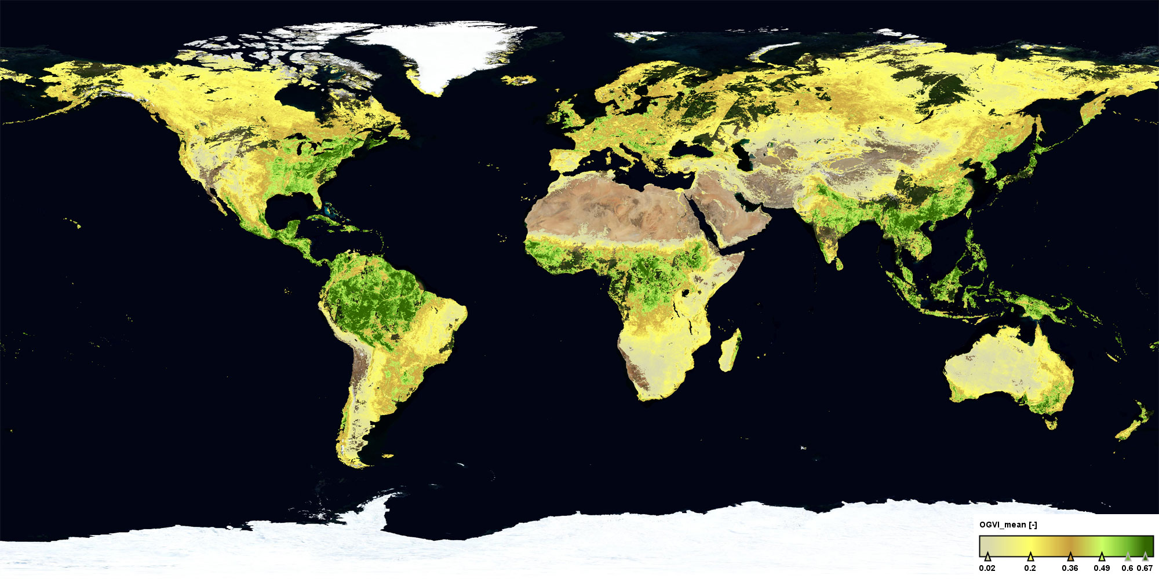
fAPAR
Fraction of absorbed photosynthetically active radiation
How much PAR is absorbed by the canopy relative to how much hits the canopy
Sentinel (ESA)

Slide 8
fAPAR
Fraction of absorbed photosynthetically active radiation
How much PAR is absorbed by the canopy relative to how much hits the canopy
What drives fAPAR variability?
Sentinel (ESA)

Slide 9
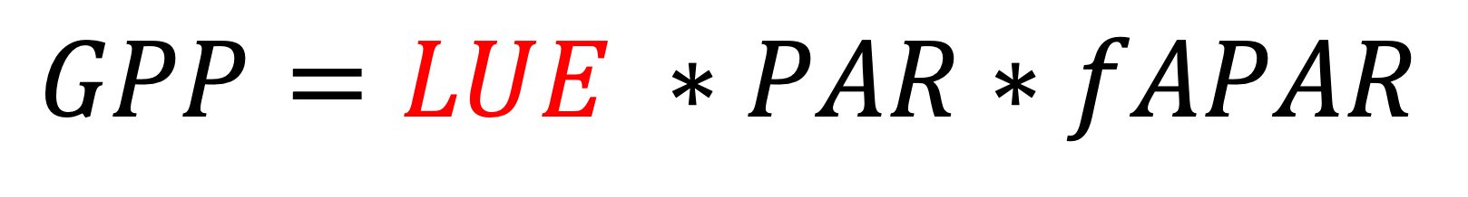
Light use efficiency models
GPP is the product of the absorbed PAR (PAR*fAPAR) and the efficiency by which PAR is converted to carbon (or LUE; µmol CO₂ µmol PAR⁻¹)
$$GPP=LUE ∗PAR∗fAPAR$$

Slide 10
Light use efficiency
This is a critical term in the model that generally tends to:
Increase with decreasing light
Vary parabolically with temperature
Increase with CO₂
Depends on
Photosynthetic biochemistry
Stomatal conductance
Intrinsic quantum efficiency of photosynthesis

Slide 11
An approach for mechanistically modeling GPP across scale: the P-model

Slide 12
The Farquhar von Caemmerer and Berry (1980) or FvCB model

Slide 13
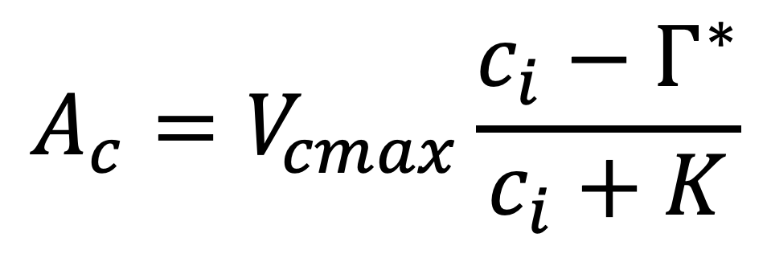
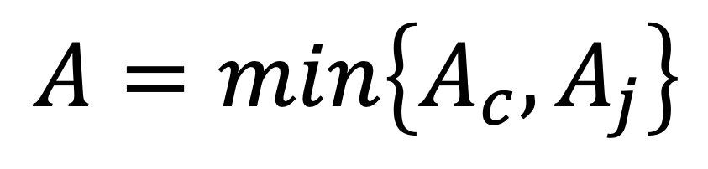
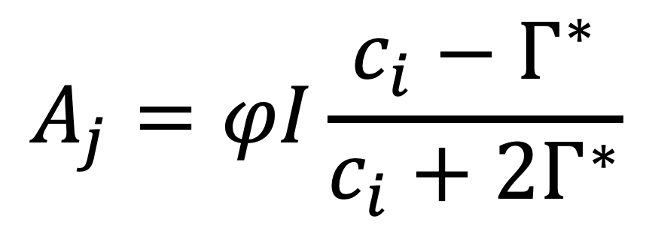
The FvCB model
$$A=min\left\{A_{c},A_{j}\right\}$$
$$A_{c}=V_{cmax}\frac{c_{i}−Γ^{∗}}{c_{i}+K}$$
$$A_{j}=φI\frac{c_{i}−Γ^{∗}}{c_{i}+2Γ^{∗}}$$
Long et al. (2003)

Slide 14
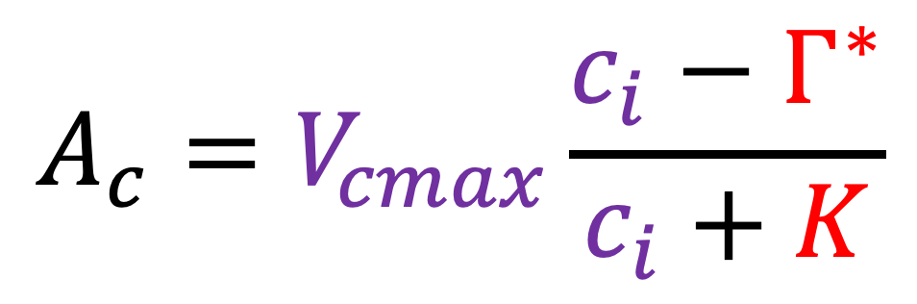
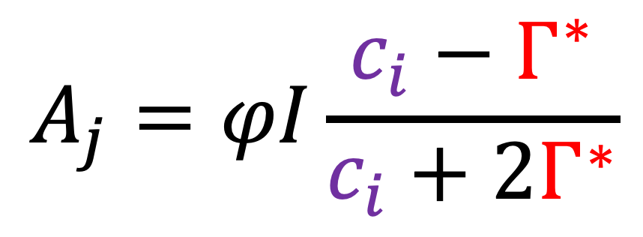
The FvCB model
Some variables have known environmental dependencies
Some can be predicted by EEO
$$A=min\left\{A_{c},A_{j}\right\}$$
$$A_{c}=V_{cmax}\frac{c_{i}−Γ^{∗}}{c_{i}+K}$$
$$A_{j}=φI\frac{c_{i}−Γ^{∗}}{c_{i}+2Γ^{∗}}$$
Long et al. (2003)

Slide 15
Key trait predictions

Slide 16
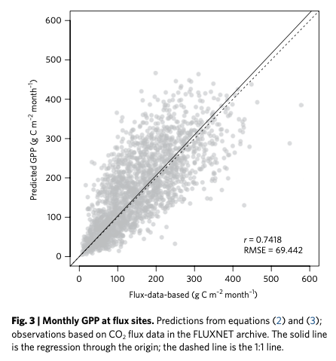
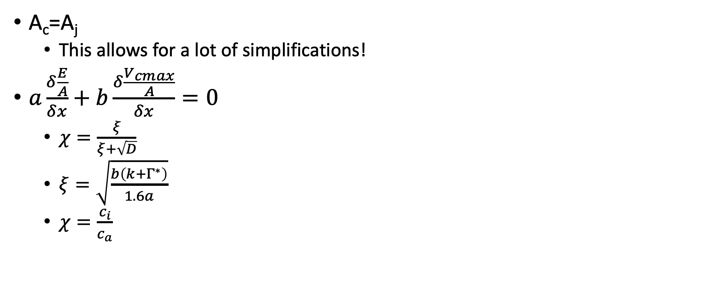
Optimally…
A_{c}=A_{j}
This allows for a lot of simplifications!
$a\frac{δ\frac{E}{A}}{δx}+$ $b\frac{δ\frac{V_{cmax}}{A}}{δx}=0$
$χ=\frac{ξ}{ξ+\sqrt{D}}$
$ξ=\sqrt{\frac{b\left(k+Γ^{∗}\right)}{1.6a}}$
$χ=\frac{c_{i}}{c_{a}}$
Wang et al. (2017)

Slide 17
Tying back to LUE

Slide 18
$$GPP=LUE ∗PAR∗fAPAR$$

Slide 19
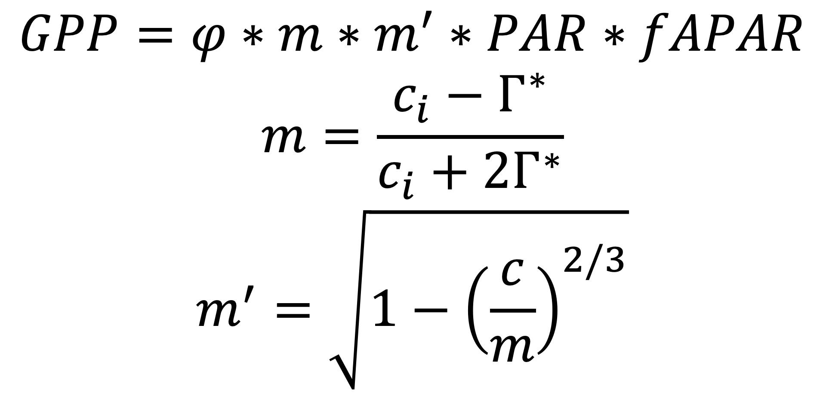
$$GPP=φ∗m∗m^{′}∗PAR∗fAPAR$$
$$m=\frac{c_{i}−Γ^{∗}}{c_{i}+2Γ^{∗}}$$
$$m^{′}=\sqrt{1−{\left(\frac{c}{m}\right)}^{2/3}}$$

Slide 20
Strengths of the P-model
No PFTs
Applicable to any environment
Requires
fAPAR (can be satellite derived)
Light, temperature, atmospheric pressure, VPD

Slide 21
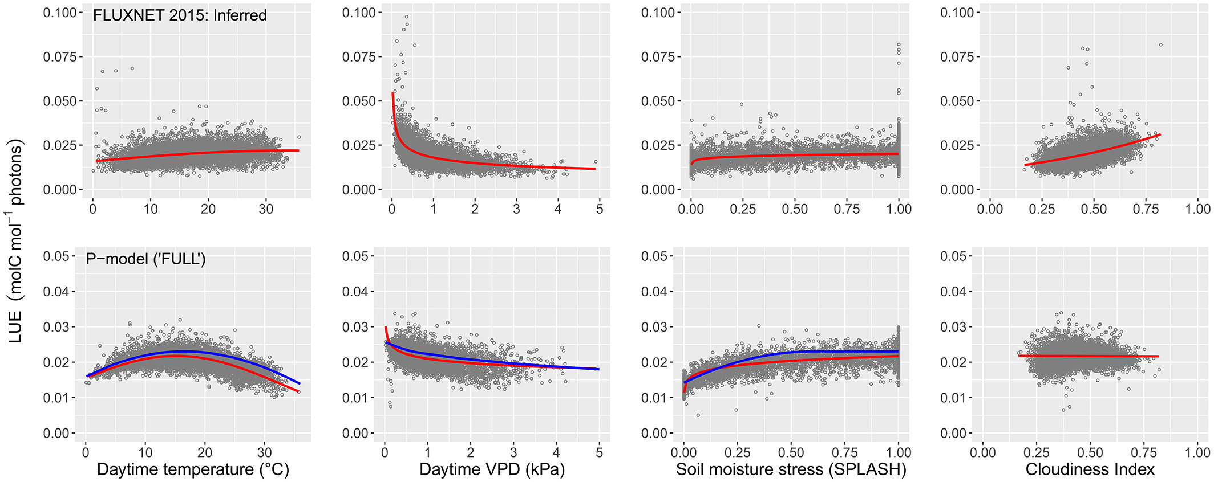
Challenges and limitations
Temperature dependence of φ
Diffuse radiation
Bloomfield et al. (2023)

Slide 22
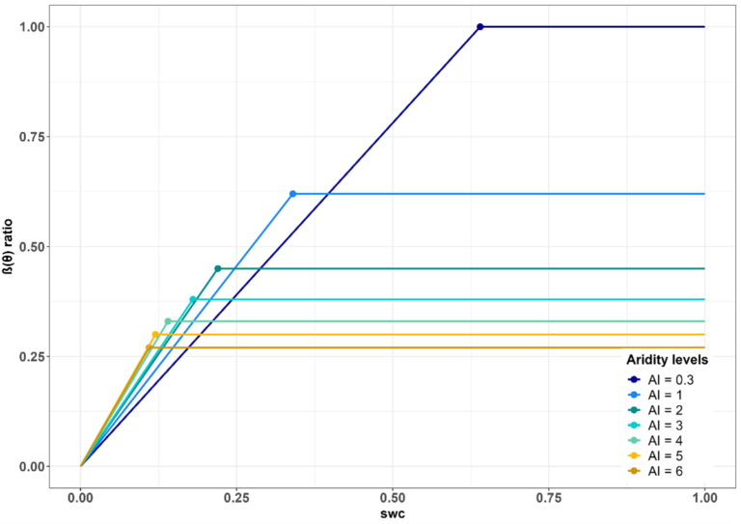
Challenges and limitations
Temperature dependence of φ
Diffuse radiation
Soil water stress
Soil nutrients
Mengoli et al. (2025)

